Slide 1
XML、Script & XmlGlue
牛靖宇
2005年12月

Slide 2
XmlGlue 简介
XmlGlue是Elastos操作系统上的一个Rich Client应用的MVC开发框架，其核心的技术是基于CAR构件技术。 XmlGlue的核心思想是使用XML / Script来描述应用的UI，而由CAR构件来完成应用的逻辑，然后由XmlGlue来完成二者的拼装，并形成一个完整的应用。这个思想在桌面应用上已经得到了较广的应用，像Mozilla的XUL，Microsoft的XAML等等，通用XmlGlue我们在嵌入式系统中也提供了相应的框架，为嵌入式应用的开发注入新的活力。

Slide 3
XmlGlue 简介(c)
XmlGlue的核心思想是“用XML来表达界面”，这个思想原本是 Mozilla的创新，在Mozilla这个技术叫XUL，Mozilla浏览器本身就是一个经典的 XUL 应用，有兴趣的可以研究一下。
Mozilla XUL / XAML / Flex / Laszlo / …

Slide 4
XmlGlue 简介(c)
Reference Projects
  Mozilla XUL: http://www.mozilla.org/projects/xul/
  Thinlet: http://www.thinlet.com/
  SwiXml: http://www.swixml.org/
  JDNC: https://jdnc.dev.java.net/
  XAML: http://www.xaml.net/
  Flex: http://www.macromedia.com/software/flex/
  Laszlo: http://www.openlaszlo.org/

Slide 5
目录
XmlGlue相关技术
XmlGlue
XmlGlue示例和分析

Slide 6
XmlGlue相关技术
MVC pattern
CAR / Reflection
XML
Script language (e.g. JavaScript, LUA, etc)
Grafix based

Slide 7
MVC pattern
In the MVC pattern, the model and the view are strictly kept apart from each other
Their interaction is mediated by the controller component: the glue that binds them together

Slide 8
MVC patten
Increases reusability by partially decoupling data presentation, data representation, and application operations. Enables multiple simultaneous data views.
Facilitates maintenance, extensibility, flexibility, and encapsulation by decoupling software layers from one another.
The Model-View-Controller ("MVC") design pattern separates the application data from both the ways the data can be viewed or accessed, and from the mapping between system events (including user interface events) and application behaviors.

Slide 9
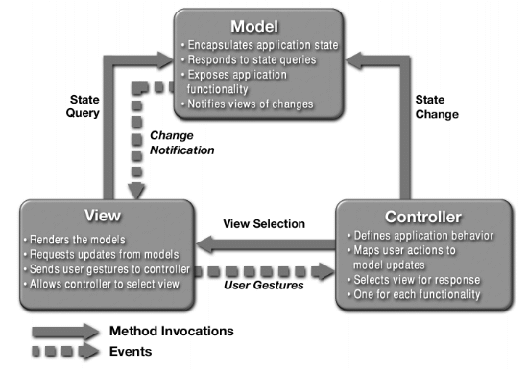
MVC Architecture

Slide 10
Model
abstracts application functionality
encapsulates the application state
provides access to application functions
manages persistence, when there is persistence
notifies interested parties when data change
Collaboration
  notifies Views when it changes application data
  can be queried by the View
  provides application functionality access to the Controller

Slide 11
View
abstracts data presentation
presents data to the user
maintains consistency with model data
Collaboration
  presents Model data to the user
  updates display when informed of data changes by the Model
  forwards user input to the Controller

Slide 12
Controller
abstracts user interaction/application semantic map
translates user inputs into application actions
select appropriate data displays based on user input and context
Collaboration
  translates user inputs into application actions on the Model
  selects the View to present based on user input and Model action outcome(s)

Slide 13
CAR / Reflection
CAR
Reflection
  通过CARC生成的Metadata，我们能够使C/C++具有高级语言如Java等所具有的反射能力
  Elastos的支持
    EzReflectClassInfo
    EzReflectInterfaceInfo
    EzReflectModuleInfo
    …

Slide 14
XML
什么是XML？
XML可以用来做什么？
为什么选择XML？

Slide 15
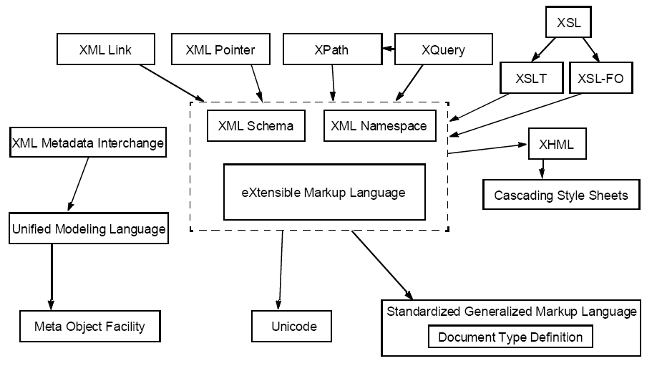
XML Specifications

Slide 16
Script Languages - JavaScript
JavaScript is a cross-platform, object-oriented scripting language; a small, lightweight language
it is not useful as a standalone language, but is designed for easy embedding in other products and applications
Inside a host environment, JavaScript can be connected to the objects of its environment to provide programmatic control over them

Slide 17
JavaScript & Java / C++
JavaScript | Java / C++
Object-oriented. No distinction between types of objects. Inheritance is through the prototype mechanism, and properties and methods can be added to any object dynamically. | Class-based. Objects are divided into classes and instances with all inheritance through the class hierarchy. Classes and instances cannot have properties or methods added dynamically.
Variable data types not declared (dynamic typing). | typing).Variable data types must be declared (static typing).

Slide 18
JavaScript “Hello World”
print(“Hello World!!!”);

Slide 19
JavaScript LiveConnect for CAR
Using CAR reflection
JavaScript demo

Slide 20
JavaScript reference
Mozilla Developer Center
  http://developer.mozilla.org/

Slide 21
目录
XmlGlue相关技术
XmlGlue
XmlGlue示例和分析

Slide 22
XmlGlue简介
简介见page2-4
XmlGlue如何工作
  一个 XML 文件被 Parser 解析，将其中引用的 Widgets (Grafix) 组装，通过 Render 显示给用户，当发生事件时，通过相应的 ScriptEngine脚本或者CAR构件来执行相应事件的处理。

Slide 23
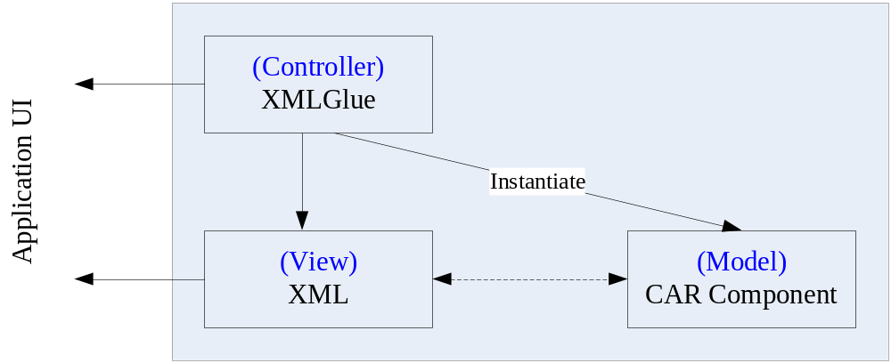
XmlGlue

Slide 24
XmlGlue “Hello World”
<x:xglue xmlns:x=http://www.koretide.com/xml-glue” xmlns:w="elactrl.dll">
<w:form left="0" top="0" width="239" height="319">
<w:label caption="Hello World!!!" left="0" top="60" width="239“
height="15" style="LabelStyle_Transparent, LabelStyle_Center"/>
</w:form>
</x:xglue>

Slide 25
XmlGlue elements
xglue
script
event
bind
forward
if
…

Slide 26
XmlGlue内置对象(暂定)
开发人员可以在程序（包括Script）中使用下列对象操作XmlGlue
  XmlGlueApplication
  XmlGlueView
  XmlGlueEvent

Slide 27
XmlGlue的优势
使用MVC直接带来的优势……
XML文件仅仅描述界面的组成，它不包含组件本身或者具体的实现技术，理论上可以运行于任何运行环境。你可以用我们的Grafix来画界面，可以用浏览器中的 SWF 引擎来画界面 (Flex/Laszlo)，可以用 Windows 的界面引擎来画界面(XAML)，可以用AWT/SWING组件来画界面(Thinlet/SwiXML/JNDC)，还可以用任何其他的技术来做这件事。此外，还可以选择不同的组件库，换一套组件，即可换一套风格。
……

Slide 28
目录
XmlGlue相关技术
XmlGlue
XmlGlue 示例和分析

Slide 29
Thanks！

